Slide 1

Session -15 Process Control
RECAP – Session14
System Calls Related to the Process
Understanding the fork() System Call
Understanding the kill() System Call
Understanding the exit() System Call
Understanding the wait() System Call

Slide 2
Recap of Session-14
We have learned the following things in the previous session
Rae Conditions
Critical Sections
Locks and Unlocks
Interrupts
Semaphore
Deadlocks

Slide 3
System Calls for the Process
Fork
Creates a New Process
Kill
Used to Send Signal to a Process OR Group of Processes
Exit
Used to Terminate the Process Execution
wait
Wait for the Process to change its State

Slide 4
Fork System Call
Fork System Call Helps the User to Create a New Process, this is the only way in Unix to create a Process.
The Process from which Fork is Invoked is Called as the Parent Process
The Newly Process is Known as the Child Process.
Syntax of Fork System Call is → Pid = fork()
Fork System call does not Take any Arguments.
After Fork is Executed Successfully both the Processes will have the Same Copies of User Level Context
But both the Processes will Differ in their Return Values of PId.
In the Parent Process Pid will have its Child PID and int Child Pid will have 0.

Slide 5
Fork System Call Contd…
Kernel will Perform the Following Tasks for the Fork System Call
It allocates a slot in the process table for the new process.
It assigns a unique ID number to the child process.
It makes a logical copy of the context of the parent process.
Since certain portions of a process, such as the text region, may be shared between processes, the kernel can sometimes increment a region reference count instead of copying the region to a new physical location in memory
It increments file and mode table counters for files associated with the process.
It returns the ID number of the child to the parent process, and a 0 value to the child process.

Slide 6
Fork Algorithm
/* Algorithm: fork
* Input: none
* Output: to parent process, child PID number
* to child process, 0 */
{
check for available kernel resources;
get free proc table slot, unique PID number;
check that user not running too many processes;
mark child state "being created";
copy data from parent proc table slot to new child slot;
increment counts on current directory inode and changed root (if applicable);
increment open file counts in file table;
make copy of parent context (u-area,text, data, stack) in memory;
push dummy system level context layer onto child system level context;
// dummy context contains data allowing child process to
// recognize itself and start running from here when scheduled
if (executing process is parent process)
{
change child state to "ready to run";
return (child ID); // from system to user
}
else // executing process is the child process
{
initialize u-area timing fields;
return (0);
}

Slide 7
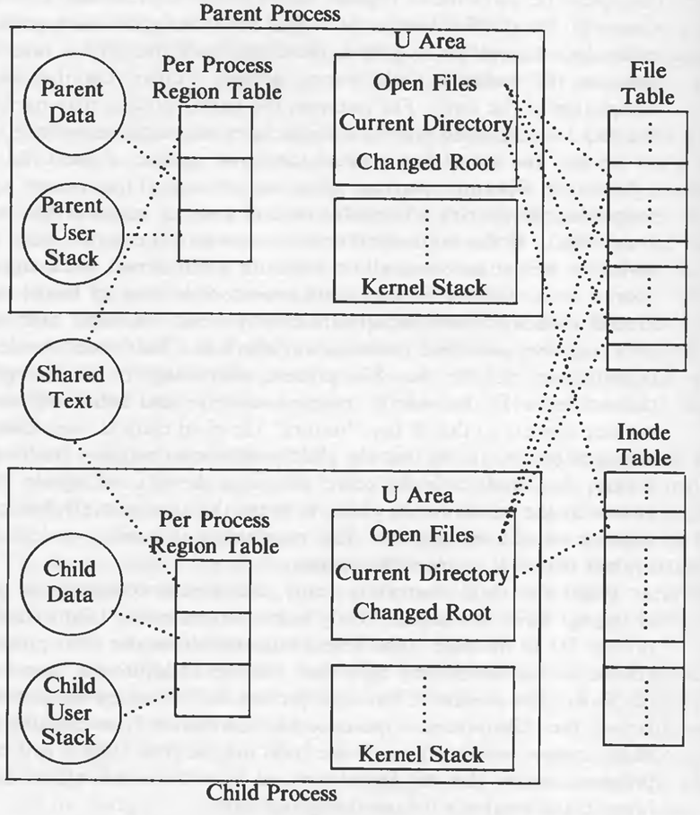
Fork Algorithm Contd…
Making a copy of a process is called forking.
Parent (is the original)
child (is the new process)
When fork is invoked,
child is an exact copy of parent
When fork is called all pages are shared between parent and child
Easily done by copying the parent’s page tables

Slide 8
Fork Algorithm Contd…
Making a copy of a process is called forking.
Parent (is the original)
child (is the new process)
When fork is invoked,
child is an exact copy of parent
When fork is called all pages are shared between parent and child
Easily done by copying the parent’s page tables

Slide 9
Fork Algorithm Contd…
The kernel first checks if it has enough resources to create a new process.
In a swapping system, it needs space either in memory or on disk to hold the child process.
On a paging system, it has to allocate memory for auxiliary tables such as page tables.
The kernel assigns a unique ID to a process.
It is one greater than the previously assigned ID.
If another process has the proposed ID number, the kernel attempts to assign the next higher ID number.
When ID numbers reach the maximum value, assignment starts from 0 again.
Since most processes execute for a short time, most ID numbers are not is use when ID assignment wraps around.

Slide 10
Fork Algorithm Contd…
The system imposes a (configurable) limit on the number of processes a user can simultaneously execute so that no user can steal many process table slots. Similarly, ordinary users cannot create a process that would occupy the last remaining slot in the process table. On the other hand, a super user can create as many processes as it wants (limited by the size of the process table.)
The kernel assigns parent process ID in the child slot, putting the child in process tree structure, and initialize various scheduling parameters, such as the initial priority value, initial CPU usage, and other timing fields. The initial state of the process is "being created".
The kernel duplicates every region in the parent process using algorithm dupreg, and attaches every region to the child process using algorithm attachreg. In a swapping system, it copies the contents of regions that are not shared into a new area of main memory.

Slide 11
Fork Algorithm Contd…
The kernel copies the parent context layer 1, containing user saved register context and the kernel stack frame of the fork system call.
If the implementation is one where the kernel stack is part of the u-area, the kernel automatically creates the child kernel stack when it creates the child u-area. Otherwise, the parent process must copy its kernel stack to a private area of memory associated with the child process.
The kernel then creates a dummy context layer 2 for the child process, containing the saved register context for context layer 1.
It sets the program counter and other registers in the saved register context so that it can "restore" the child context, even though it had never executed before, and so that the child process can recognize itself as the child when it runs. For instance, if the kernel code tests the value of register 0 to decide if the process is the parent or the child, it writes the appropriate value in the child saved register context in layer 1.

Slide 12
Fork Algorithm Contd…
When the child context is ready, the parent completes its part of fork by changing the child state to "ready to run (in memory)" and by returning the child process ID to the user. The kernel later schedules the child process for execution via the normal scheduling algorithm, and the child process "completes" its part of the fork. The context of the child process was set up by the parent process; to the kernel, the child process appears to have awakened after awaiting a resource. The child process executes part of the code for the fork system call, according to the program counter that the kernel restored from the saved register context in context layer 2, and returns a 0 from the system call.
The figure give a logical view of the parent and child processes and their relationship with the kernel data structures immediately after completion of the fork system call:

Slide 13
Copy on Write (COW)
Fork Algorithm Contd…
i of child here
i of parent here
When data in any of the shared pages change, OS intercepts and makes a copy of the page. Thus, parent and child will have different copies of this page
Parent Page Table
Why?
A large portion of executables are not used. Copying each page from parent and child would incur significant disk swapping and huge performance penalties. Postpone coping of pages as much as possible thus optimizing performance
Child Page Table
This page now is no longer shared
13

Slide 14
Fork Algorithm Contd…
Each process has a page table which maps its virtual addresses to physical addresses.
When the fork() operation is performed, then each process has a new page table created in which each entry is marked with a ‘‘copy-on-write’’ flag.
this is also done for the caller’s address space. When the contents of memory are to be updated, the flag is checked. If it is set, a new page is allocated, the data from the old page copied, the update is made on the new page, and the ‘‘copy-on-write’’ flag is cleared for the new page. Thus, unexpected changes to shared state do not occur, as independent copies are created ‘‘on demand’’.
This is very effective in the special case of the shell, where almost no copying has to be done before an exec() replaces the address space.
If the resources are unavailable, the fork call fails. The kernel finds a slot in the process table to start constructing the context of the child process and makes sure that the user doing the fork does not have too many processes already running.

Slide 15
Fork Algorithm in XV6
2579 int
2580 fork(void)
2581 {
2582 int i, pid;
2583 struct proc *np;
2584 struct proc *curproc = myproc();
2585
2586 // Allocate process. → 1
2587 if((np = allocproc()) == 0){
2588 return −1;
2589 }
2590
2591 // Copy process state from proc.
2592 if((np−>pgdir = copyuvm(curproc−>pgdir, curproc−>sz)) == 0){
2593 kfree(np−>kstack);
2594 np−>kstack = 0;
2595 np−>state = UNUSED;
2596 return −1;
2597 }
2598 np−>sz = curproc−>sz;
2599 np−>parent = curproc;

Slide 16
Fork Algorithm in XV6 contd…
2600 *np−>tf = *curproc−>tf;
2601
2602 // Clear %eax so that fork returns 0 in the child.
2603 np−>tf−>eax = 0;
2604
2605 for(i = 0; i < NOFILE; i++)
2606 if(curproc−>ofile[i])
2607 np−>ofile[i] = filedup(curproc−>ofile[i]);
2608 np−>cwd = idup(curproc−>cwd);
2609
2610 safestrcpy(np−>name, curproc−>name, sizeof(curproc−>name));
2611
2612 pid = np−>pid;
2613
2614 acquire(&ptable.lock);
2615
2616 np−>state = RUNNABLE;
2617
2618 release(&ptable.lock);
2619
2620 return pid;
2621 }

Slide 17
Process Structure in XV6
2334 enum procstate { UNUSED, EMBRYO, SLEEPING, RUNNABLE, RUNNING, ZOMBIE };
2337 struct proc {
2338 uint sz; // Size of process memory (bytes)
2339 pde_t* pgdir; // Page table
2340 char *kstack; // Bottom of kernel stack for this process
2341 enum procstate state; // Process state
2342 int pid; // Process ID
2343 struct proc *parent; // Parent process
2344 struct trapframe *tf; // Trap frame for current syscall
2345 struct context *context; // swtch() here to run process
2346 void *chan; // If non−zero, sleeping on chan
2347 int killed; // If non−zero, have been killed
2348 struct file *ofile[NOFILE]; // Open files
2349 struct inode *cwd; // Current directory

Slide 18
Allocating the Process in XV6
2468 // Look in the process table for an UNUSED proc.
2469 // If found, change state to EMBRYO and initialize
2470 // state required to run in the kernel.
2471 // Otherwise return 0.
2472 static struct proc*
2473 allocproc(void)
2474 {
2475 struct proc *p;
2476 char *sp;
2477
2478 acquire(&ptable.lock);
2479
2480 for(p = ptable.proc; p < &ptable.proc[NPROC]; p++)
2481 if(p−>state == UNUSED)
2482 goto found;
2483
2484 release(&ptable.lock);
2485 return 0;
2486
2487 found:
2488 p−>state = EMBRYO;
2489 p−>pid = nextpid++;
2490
2491 release(&ptable.lock);
2492
2493 // Allocate kernel stack.
2494 if((p−>kstack = kalloc()) == 0){
2495 p−>state = UNUSED;
2496 return 0;
2497 }
2498 sp = p−>kstack + KSTACKSIZE;

Slide 19
Signals
Signals inform processes of the occurrence of asynchronous events.
Processes may send each other signals with the kill system call, or the kernel may send signals internally.
There are 19 signals in the System V (Release 2) UNIX system that can be classified as follows:
Signals having to do with the termination of a process, send when a process exits or when a process invokes the signal system call with the death of child parameter.
Signals having to do with process induced exceptions such as when a process accesses an address outside its virtual address space, when it attempts to write memory that is read-only (such as program text), or when it executes a privileged instruction or for various hardware errors.
Signals having to do with the unrecoverable conditions during a system call, such as running out of system resources during exec after the original address space has been released

Slide 20
Signals Contd…
Signals originating from a process in user mode, such as when a process wishes to receive an alarm signal after a period of time, or when processes send arbitrary signals to each other with the kill system call.
Signals related to terminal interaction such as when a user hands up a terminal (or the "carrier" signal drops on such a line for any reason), or when a user presses the "break" or "delete" keys on a terminal keyboard.
Signals for tracing execution of a process.
When a kernel or a process sends a signal to another process, a bit in the process table entry of that process is set, with respect to the type of signal received. If the process is asleep at an interruptible priority, the kernel awakens it. A process can remember different types of signals but it cannot remember how many times a signal of a particular type was received.

Slide 21
Handling Signals
The kernel handles signals in the context of the process that receives them so a process must run to handle signals.
There are three cases for handling signals: the process exits on receipt of the signal, it ignores the signal, or it executes a particular (user) function on receipt of the signal.
The default action is to call exit in kernel mode, but a process can specify special action to take on receipt of certain signals with the signal system call.
old function = signal (signum, function);

Slide 22
Handling Signals
where signum is the signal number the process is specifying the action for, function is the address of the (user) function the process wants to invoke on receipt of the signal, and the return value old function was the value of function in the most recently specified call to signal for signum.
The process can pass the values 1 or 0 instead of a function address: The process will ignore future occurrences of the signal if the parameter value is 1 and exit in the kernel on receipt of the signal if its value is 0 (default value).
The u-area contains an array of signal-handler fields, one for each signal defined in the system. The kernel stores the address of the user function in the field that corresponds to the signal number.

Slide 23
Processes Termination
Voluntary : exit(status)
OS passes exit status to parent via wait(&status)
OS frees process resources
Involuntary : kill(pid, signal)
Signal can be sent by another process or by OS
pid is for the process to be killed
signal a signal that the process needs to be killed
Examples : SIGTERM, SIGQUIT (ctrl+\), SIGINT (ctrl+c), SIGHUP

Slide 24
Process Termination Exit
Processes on the UNIX system exit by executing the exit system call. When a process exits, it enters the zombie state, relinquishes all of its resources, and dismantles its context except for its process table entry.
The exit() system call ends a process and returns a value to it parent. The prototype for the exit() system call is: exit (status);
where status is an integer between 0 and 255.
This number is returned to the parent via wait() as the exit status of the process. By convention, when a process exits with a status of zero that means it didn't encounter any problems; when a process exit with a non-zero status that means it did have problems.
exit() is actually not a system routine
it is a library routine that call the system routine _exit(). exit() cleans up the standard I/O streams before calling _exit(), so any output that has been buffered but not yet actually
written out is flushed.
Calling _exit() instead of exit() will bypass this clean up procedure. exit() does not return.

Slide 25
Process Termination Exit
/* Algorithm: exit Input: return code for parent process Output: none */
{
ignore all signals;
if (process group leader with associated control terminal)
{
send hangup signal to all members of the process group;
reset process group for all members to 0;
}
close all open files (internal version of algorithm close);
release current directory (algorithm: iput);
release current (changed) root, if exists (algorithm: iput);
free regions, memory associated with process (algorithm: freereg);
write accounting record;
make process state zombie;
assign parent process ID for all child processes to be init process (1);
if any children were zombie, send death of child signal to init;
send death of child signal to parent process;
context switch;
}

Slide 26
Exit in XV6
2623 // Exit the current process. Does not return.
2624 // An exited process remains in the zombie state
2625 // until its parent calls wait() to find out it exited.
2626 void
2627 exit(void)
2628 {
2629 struct proc *curproc = myproc();
2630 struct proc *p;
2631 int fd;
2632
2633 if(curproc == initproc)
2634 panic("init exiting");
2635
2636 // Close all open files.
2637 for(fd = 0; fd < NOFILE; fd++){
2638 if(curproc−>ofile[fd]){
2639 fileclose(curproc−>ofile[fd]);
2640 curproc−>ofile[fd] = 0;
2641 }
2642 }

Slide 27
Processes Termination Kill
Processes use the kill system call to send signals.
kill (pid, signum);
where pid identifies the set of processes to receive the signal, and signum is the signal number being sent. The following list shows the correspondence between values of pid and sets of processes.
If pid is a positive integer, the kernel sends the signal to the process with process ID pid.
If pid is 0, the kernel sends the signal to all processes in the sender's process group.
If pid is -1, the kernel sends the signal to all processes whose real user ID equals the effective user ID of the sender (real and effective user IDs are studied later). If the sending process has effective user ID of superuser, the kernel sends the signal to all processes except processes 0 and 1.
If pid is a negative integer but not -1, the kernel sends the signal to all processes in the process group equal to the absolute value of pid.

Slide 28
Kill in XV6
2971 // Kill the process with the given pid.
2972 // Process won’t exit until it returns
2973 // to user space (see trap in trap.c).
2974 int
2975 kill(int pid)
2976 {
2977 struct proc *p;
2978
2979 acquire(&ptable.lock);
2980 for(p = ptable.proc; p < &ptable.proc[NPROC]; p++){
2981 if(p−>pid == pid){
2982 p−>killed = 1;
2983 // Wake process from sleep if necessary.
2984 if(p−>state == SLEEPING)
2985 p−>state = RUNNABLE;
2986 release(&ptable.lock);
2987 return 0;
2988 }
2989 }
2990 release(&ptable.lock);
2991 return −1;
2992 }

Slide 29
When a child exits, it does not die immediately. Instead, it switches to the ZOMBIE process state until the parent calls wait to learn of the exit.
The parent is then responsible for freeing the memory associated wit h the process and preparing the struct proc for reuse.
If the parent exits before the child, the init process adopts the child and waits for it, so that every child has a parent to clean up after it.
Exit acquires ptable.lock and then wakes up any process sleeping on a wait channel equal to the current process’s parent proc(2651); if there is such a process, it will be the parent in wait.
This may look premature, since exit has not marked the current process as a ZOMBIE yet, but it is safe: although wakeup may cause the parent to run, the loop in wait cannot run until exit releases ptable.lock by calling sched to enter the scheduler, so wait can’t look at the exiting process until after exit has set its state to ZOMBIE(2663). Before exit yields the processor, it reparents all of the exiting process’s children, passing them to the initproc(2653-2660). Finally, exit calls sched to relinquish the CPU.

Slide 30
Zombies
When a process terminates it becomes a zombie (or defunct process)
PCB in OS still exists even though program no longer executing
Why?
So that the parent process can read the child’s exit status (through wait system call)
When parent reads status zombie entries removed from OS… process reaped!
Suppose parent does not read status Zombie will continue to exist infinitely … a resource leak
These are typically found by a reaper process

Slide 31
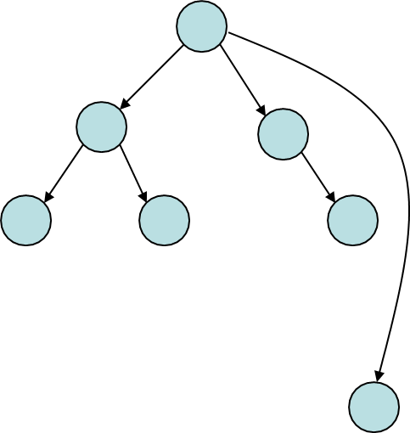
Orphans
When a parent process terminates before its child Adopted by first process (/sbin/init)
Unintentional orphans
When parent crashes
Intentional orphans
Process becomes detached from user session and runs in the background
Called daemons, used to run background services
See nohup

Slide 32
Wait system call
The wait() system call suspends execution of the calling process until one of its children terminates. The call wait(&status) is equivalent to: waitpid(-1, &status, 0);
The waitpid() system call suspends execution of the calling process until a child specified by pid argument has changed state. By default, waitpid() waits only for terminated children, but this behaviour is modifiable via the options argument, as described below.
The Value of PId can be one from the following
< -1 → Wait for any child process whose group Id is equal to the obsolute value of Pid
-1 → Wait for any child Process
0 → wait for any child process whose process group ID is equal to that of the calling process.
> 0 → meaning wait for the child whose process ID is equal to the
value of pid

Slide 33
Wait system call code in xv6
2668 // Wait for a child process to exit and return its pid.
2669 // Return −1 if this process has no children.
2670 int
2671 wait(void)
2672 {
struct proc *p;
int havekids, pid;
struct proc *curproc = myproc();
acquire(&ptable.lock);
for(;;){
// Scan through table looking for exited children.
havekids = 0;
for(p = ptable.proc; p < &ptable.proc[NPROC]; p++){
if(p−>parent != curproc)
continue;
havekids = 1;
if(p−>state == ZOMBIE){
// Found one.
pid = p−>pid;
kfree(p−>kstack);
p−>kstack = 0;
freevm(p−>pgdir);
p−>pid = 0;
p−>parent = 0;
p−>name[0] = 0;
p−>killed = 0;
p−>state = UNUSED;
release(&ptable.lock);
return pid;
}
}

Slide 34
Wait system call code in xv6
2700 // No point waiting if we don’t have any children.
2701 if(!havekids || curproc−>killed){
2702 release(&ptable.lock);
2703 return −1;
2704 }
2705
2706 // Wait for children to exit. (See wakeup1 call in proc_exit.)
2707 sleep(curproc, &ptable.lock);
2708 }
2709 }

Slide 35
Thank You

